Slide 1
Involving patients and the public in missing data; insights from PAPrKA
Lynn Laidlaw
Patent and Public Co Investigator
Health Research from Home

Slide 2
What is PAPrKA?
HRfH driver project
Using retrospective data from selected smartphones and wearables to look at physical activity pre and post knee replacement
Currently recruiting

Slide 3
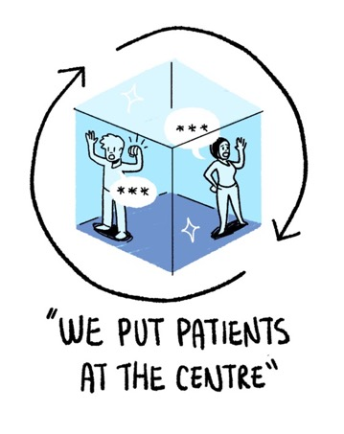
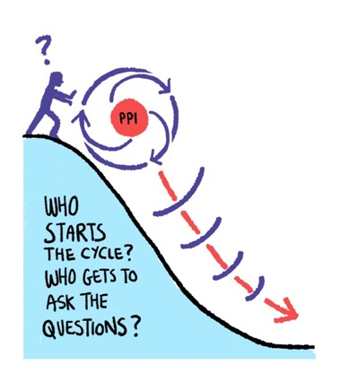
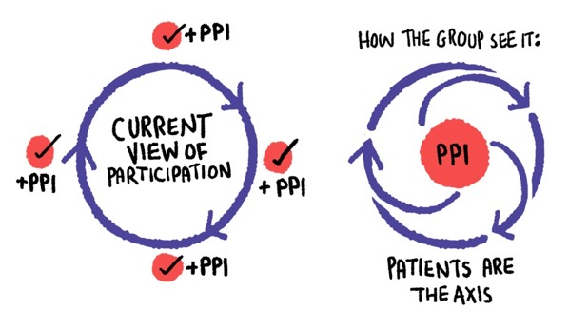
From “More than a method: trusting relationships, productive tensions and two way learning as mechanisms of authentic co production. Sarah E. Knowles et al, illustrations Chris Redford

Slide 4
Why involve patients and the public in missing data?
Making sure methods match real world device use, its not just a technical problem to be overcome
Insight regarding, why, when and for how long can gaps occur
Research results affect people living with conditions, including the care, treatments and interventions that they can access

Slide 5
Reflexivity: how can we learn?
“Reflexivity is the act of examining one's own assumption, belief, and judgement systems, and thinking carefully and critically about how these influence the research process.”
Key question: “What is the research process and how am I influencing it?”
Uncommon in quantitative research, so needs shift in thinking
Is PPI a first step in promoting reflexivity in quantitative research?

Slide 6
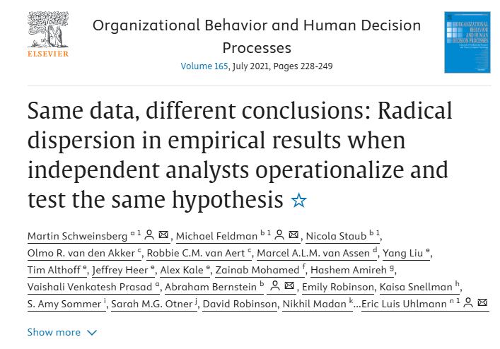

Slide 7
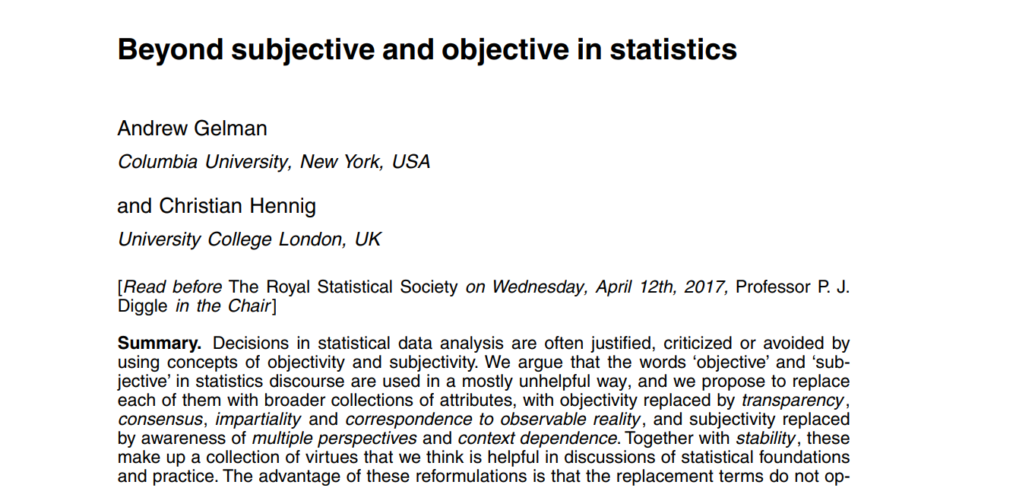

Slide 8
What did we do?
Met with members of the Patient Advisory Group (PAG) to discuss missing data
Mix of people who have had a knee replacement and those interested in using smartphones and wearables for research
Explained the issue with missing data and the methods used to fill in the gaps

Slide 9
Shared insights
Lots of reasons why data may be missing, not always due to inactivity
Context is important, especially when using retrospective data. Why are people using the devices, what is their purpose?
Charging, feeling unwell, seasons of the year, lifestyle, priorities etc can all affect device use
Missing data from the persons perspective, do devices capture things of interest to them?
Device use isn’t static, an individuals use and context changes
People aren’t data points

Slide 10
continued
Issue of incorrect and misinterpreted data ( clapping and ironing!)
Issue of complete trust in devices and the impact of incorrect and misinterpreted data eg worry
Recognition of “it depends” and research potentially using devices for a purpose of which they weren’t intended
Importance of using relative step count, people are individuals and it needs to be on a case by case basis
How you present data and patterns of recovery are important, eg labelling it fast, intermediate and slow.

Slide 11
Reflections
Missing data isn’t just a methodological issue, it needs to be centred in real life experience and insights
Reflexivity is crucial for all research, not just qualitative
Understand the purpose, be transparent and make the task clear
Close the feedback loop, let people know how their insights and experiences have been used
Recognise different types of expertise and experience, it adds to research

Slide 12
